Slide 1

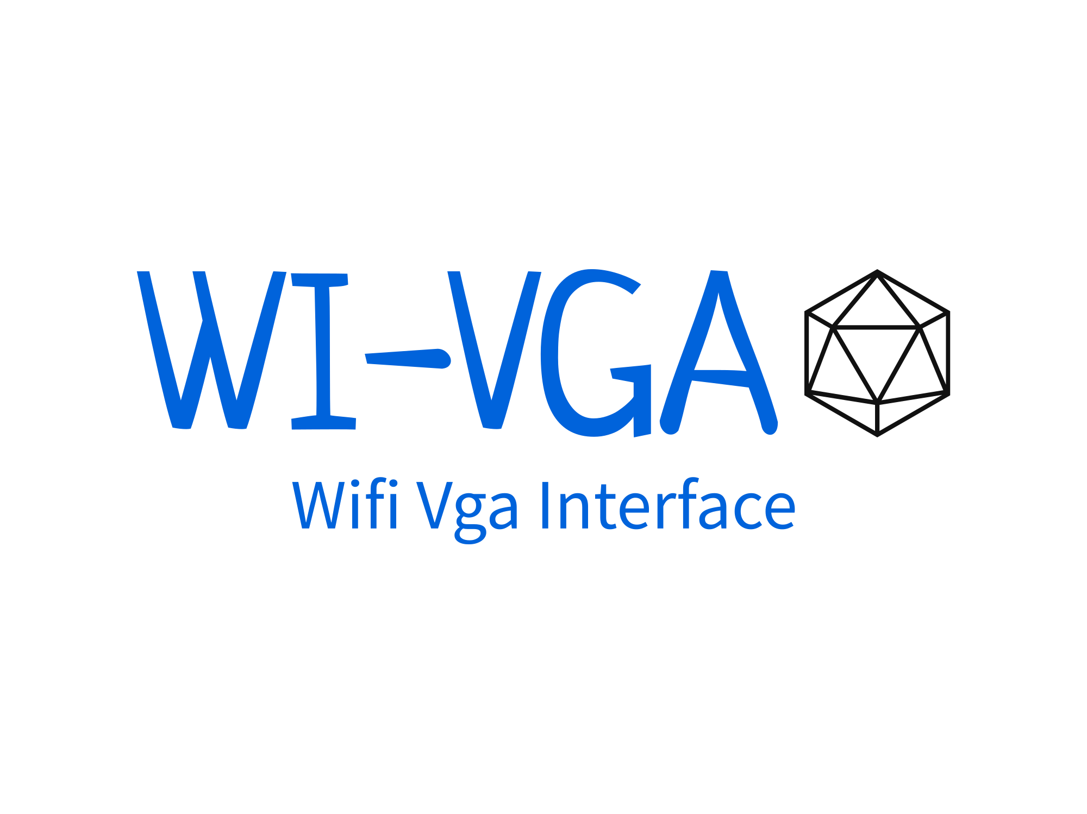
Project supervisor
Dr. Hossam Eldin Mostafa

Slide 2
Table of Contents
01
02
03
04
Introduction
ESP32
VGA
bitluni's ESP32Lib

Slide 3
Table of Contents
05
06
07
08
DAC
APP
PWA VS FLUTTER
CONCLUSION

Slide 4
Table of Contents
09
10
07
FUTURE WORK
REFERENCE
08

Slide 5
01
Introduction

Slide 6

WI-VGA
WHY | WHAT | HOW

Slide 7
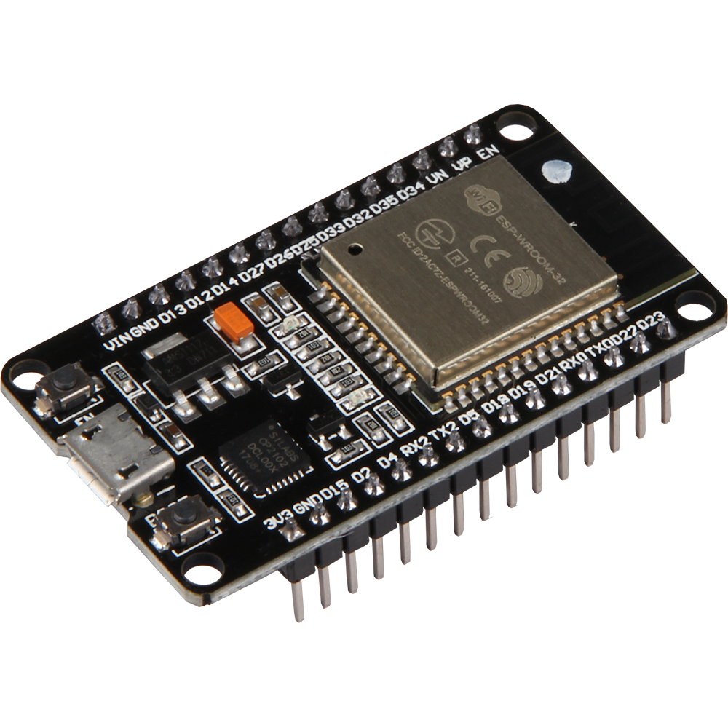
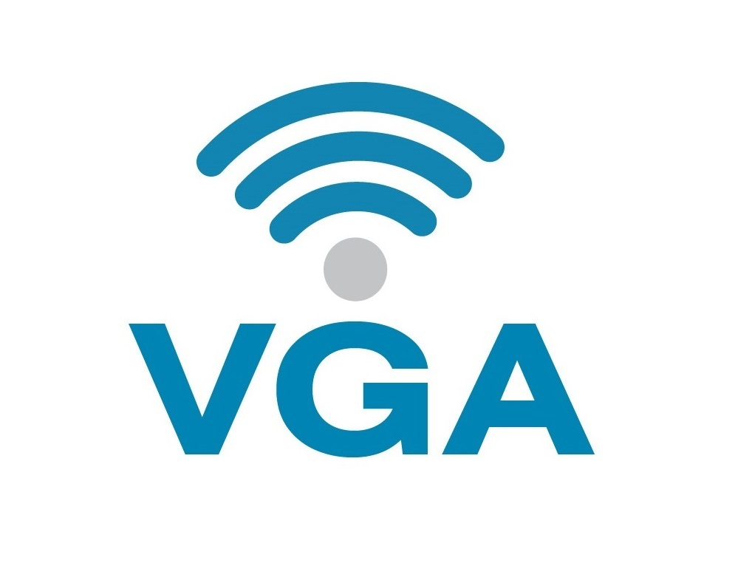

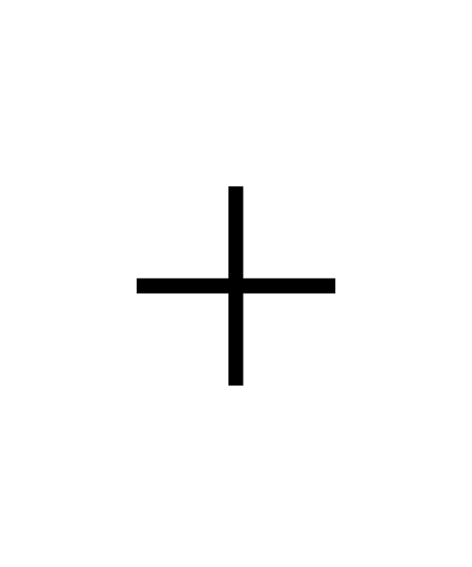
WHAT IS WI-VGA?
SMART VGA
GENERIC

Slide 8
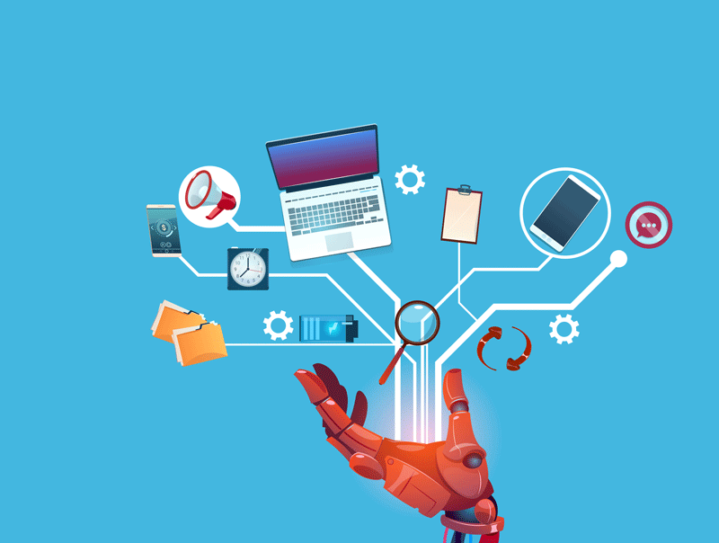
WHY WI-VGA?
ADVERTISING
PRESENTATION
ETC……

Slide 9
HOW TO USE? (Program Cycle)
Connect ESP32 to VGA
Access application
To upload or delete image
1
2
3
4
Connect to ESP using wifi
OR
Connect ESP to router using wifi
Display uploaded images

Slide 10
Building process
Hardware
Software
ESP32
VGA INTERFACE
bitluni's ESP32Lib
DAC
APP
PWA

Slide 11
HARDWARE

Slide 12
02
ESP32

Slide 13
ESP32 VS NodeMCU
Feature | ESP32 | NodeMCU
Microcontroller | Dual-core Tensilica LX6 | Single-core ESP8266
Clock Speed | Up to 240 MHz | Up to 160 MHz
Memory | 520 KB SRAM, 4 MB Flash | 80 KB SRAM, 4 MB Flash
Wi-Fi | IEEE 802.11 b/g/n | IEEE 802.11 b/g/n
Bluetooth | Bluetooth v4.2 BR/EDR and BLE | Not built-in

Slide 14
ESP32 VS NodeMCU
Feature | ESP32 | NodeMCU
Pins | Up to 36 GPIO pins | Up to 11 GPIO pins, some shared with Flash
Digital Outputs | 20 PWM channels (resolution up to 16) | 1 PWM channel
Price | $3.00 - $10.00 | $3.00 - $7.00 (depending on model)

Slide 15
03
VGA

Slide 16
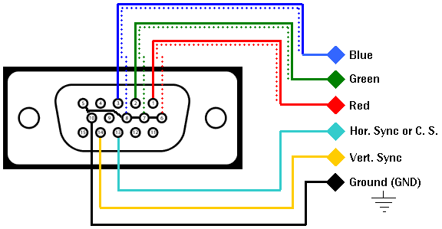
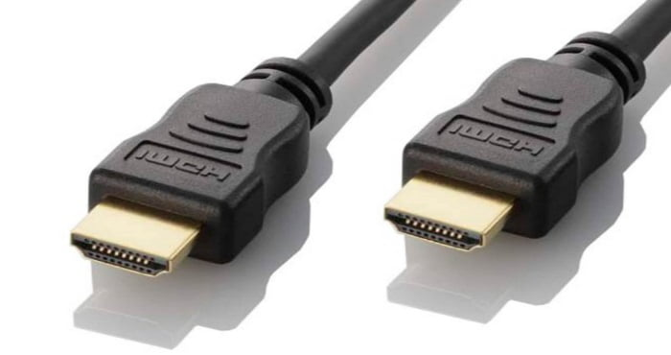
VGA VS HDMI
Both common video interfaces used to connect devices to displays.

Slide 17
VGA
VGA is an analog video interface that was introduced in 1987.
VGA is commonly used for connecting computers to displays.
VGA supports resolutions up to 1920x1080 (1080p).

Slide 18
HDMI
HDMI is a digital video interface that was introduced in 2002.
HDMI is commonly used for connecting devices such as gaming consoles, Blu-ray players, and streaming devices to displays.
HDMI supports resolutions up to 4K (3840x2160).

Slide 19
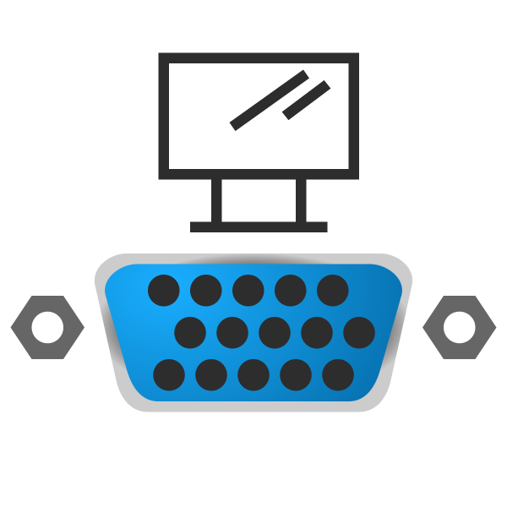
VGA VS HDMI
Widespread Compatibility
Simplicity
Cost-Effectiveness
Notes:
Widespread Compatibility: VGA has been around for a long time and is widely supported by a range of devices, including older computers, projectors, and displays. This compatibility makes it a reliable choice for presentations, especially when dealing with legacy hardware.
Simplicity: VGA is a straightforward analog interface, requiring minimal setup. It doesn't require any digital encoding or decoding processes, making it easy to connect and use for presentations.
Cost-Effectiveness: VGA cables are generally more affordable than HDMI cables. This affordability can be beneficial if you need to set up multiple presentation systems or if you're working on a tight budget.

Slide 20
VGA INTERFACE

Slide 21
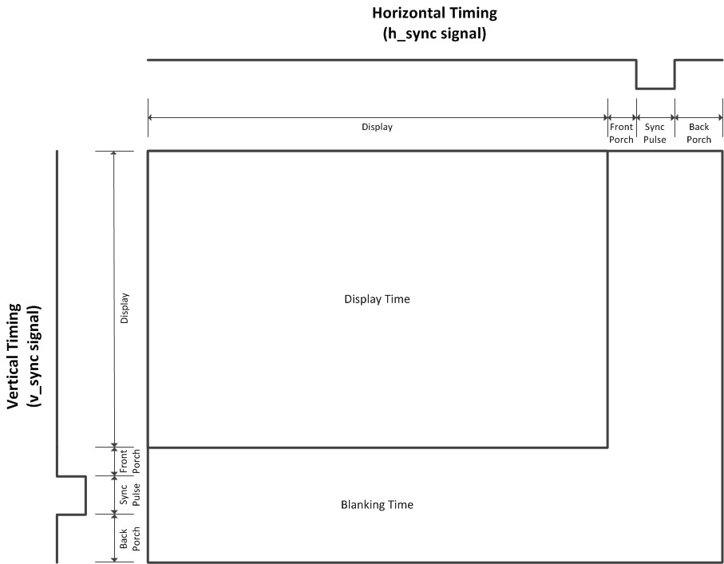

Slide 22
04
bitluni's ESP32Lib

Slide 23
Fabgl ESP32Lib
Easy to use: Provides a straightforward API for creating GUI applications
Resource-efficient: Optimized for ESP32's limited resources (RAM, flash memory)
Cross-platform: Compatible with various display technologies and touch controllers

Slide 24
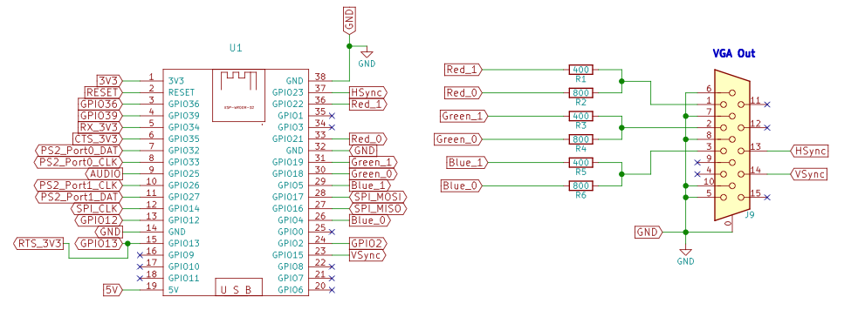
Fabgl ESP32Lib

Slide 25
bitluni's ESP32Lib
Versatile: Enables the creation of diverse multimedia applications, from visual displays to interactive installations
Creative Freedom: Empowers artists, makers, and developers to explore unique projects with rich multimedia capabilities
Hardware Compatibility: Works seamlessly with various display technologies, sensors, and audio devices

Slide 26
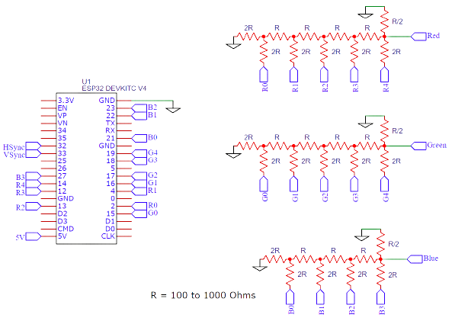
bitluni's ESP32Lib

Slide 27

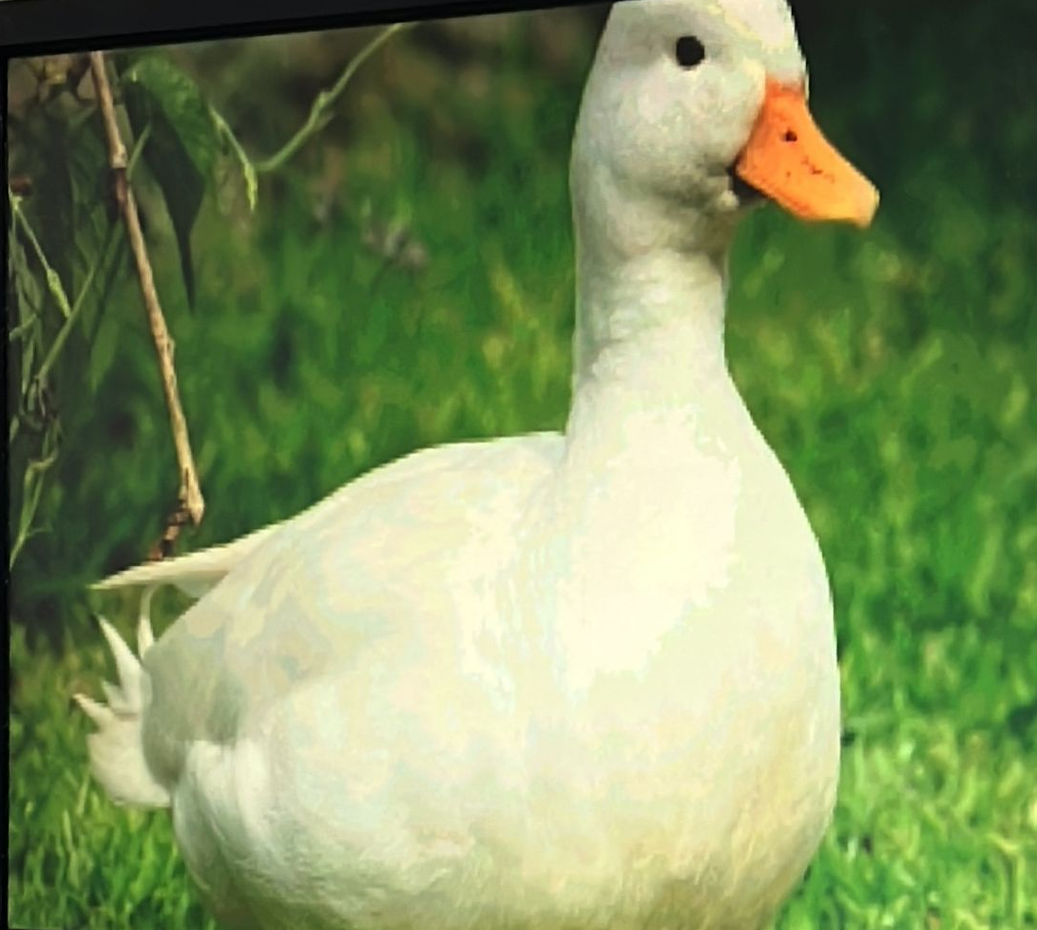
Fabgl ESP32Lib | bitluni's ESP32Lib
Output can be configured such 64 colors are displayed. | Can output full RGB color.

Slide 28
05
DAC

Slide 29
DAC
Binary DAC
R-2R DAC
Delta-Sigma DAC
Current-Steering DAC
Multibit DAC
Time-Interleaved DAC
Notes:
Binary DAC: A binary DAC, also known as a resistor ladder DAC, is the simplest type of DAC. It uses a network of resistors to create voltage levels corresponding to the binary input values. The output is a stepped analog waveform. Binary DACs are relatively easy to implement but suffer from limited resolution and accuracy.
R-2R DAC: An R-2R DAC is a type of binary-weighted DAC that uses a network of resistors arranged in a ladder-like structure. It provides improved resolution compared to a binary DAC and can achieve higher accuracy. R-2R DACs are commonly used in audio applications where higher fidelity is desired.
Delta-Sigma DAC: Delta-sigma DACs use a technique called delta-sigma modulation to achieve high-resolution conversion. They oversample the input signal and use noise shaping to push quantization noise out of the audio band, resulting in improved signal quality. Delta-sigma DACs are commonly found in high-end audio equipment and digital audio systems.
Current-Steering DAC: Current-steering DACs, also known as current-switching DACs, use a combination of current sources and switches to generate analog output voltages. They offer high-speed conversion and can support multi-channel applications. Current-steering DACs are commonly used in applications such as video signal processing and wireless communication systems.
Multibit DAC: Multibit DACs, also known as multilevel or sigma-delta DACs, use multiple bits to represent each output sample. They offer improved linearity and lower distortion compared to binary-weighted DACs. Multibit DACs are used in high-fidelity audio applications where accurate reproduction of small signal details is important.
Time-Interleaved DAC: Time-interleaved DACs utilize multiple DAC channels operating in parallel and time-interleaved fashion to increase the overall conversion speed. By splitting the input signal into multiple channels, each running at a fraction of the total sample rate, time-interleaved DACs can achieve higher conversion rates. They are commonly used in applications such as software-defined radios and high-speed data acquisition systems.

Slide 30
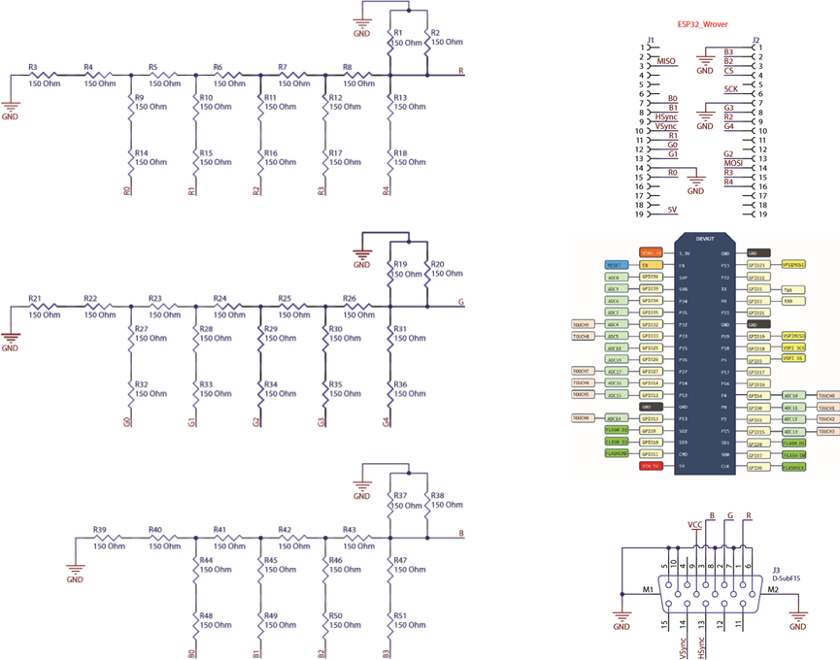
DAC

Slide 31
SOFTWARE

Slide 32
06
APP

Slide 33
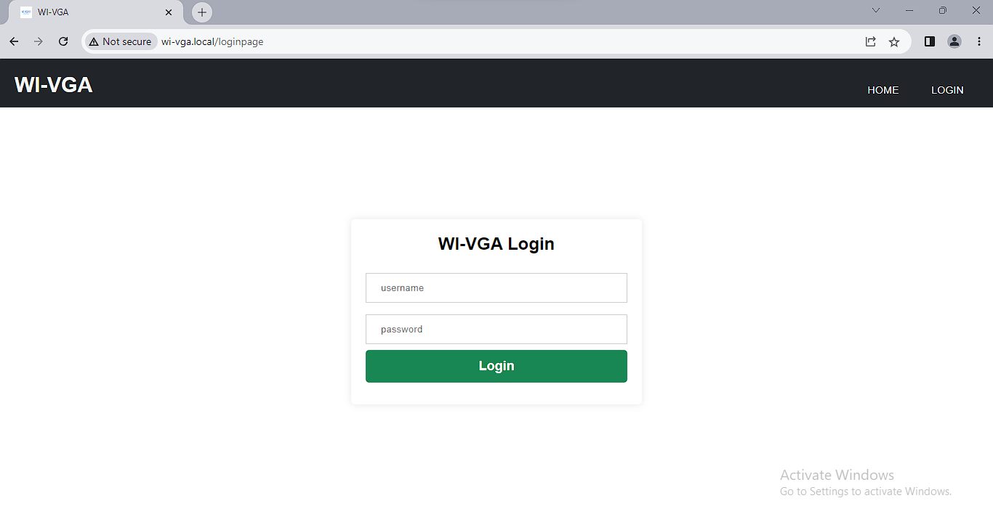
SCREEENSHOT

Slide 34
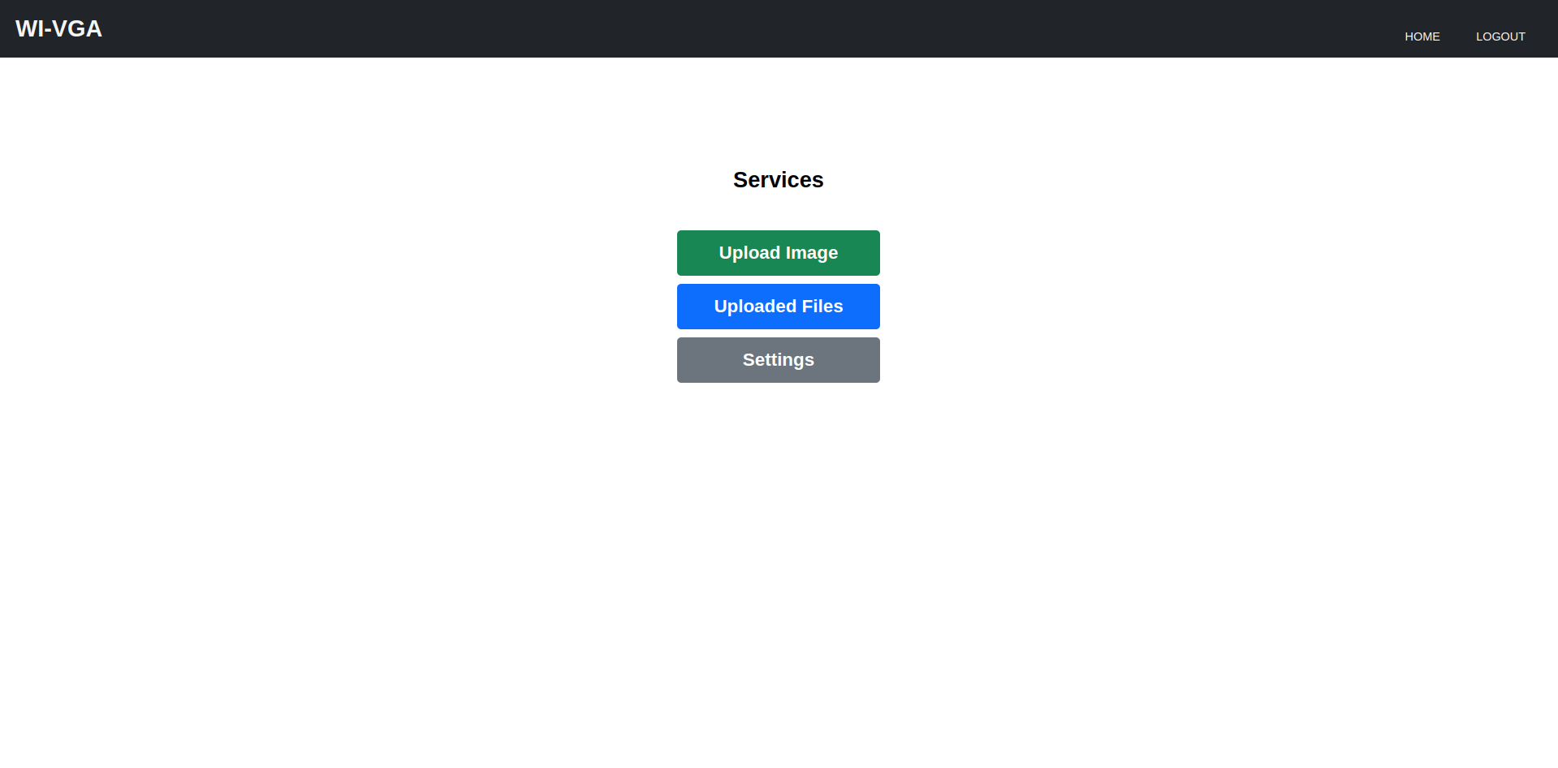
SCREENSHOT

Slide 35
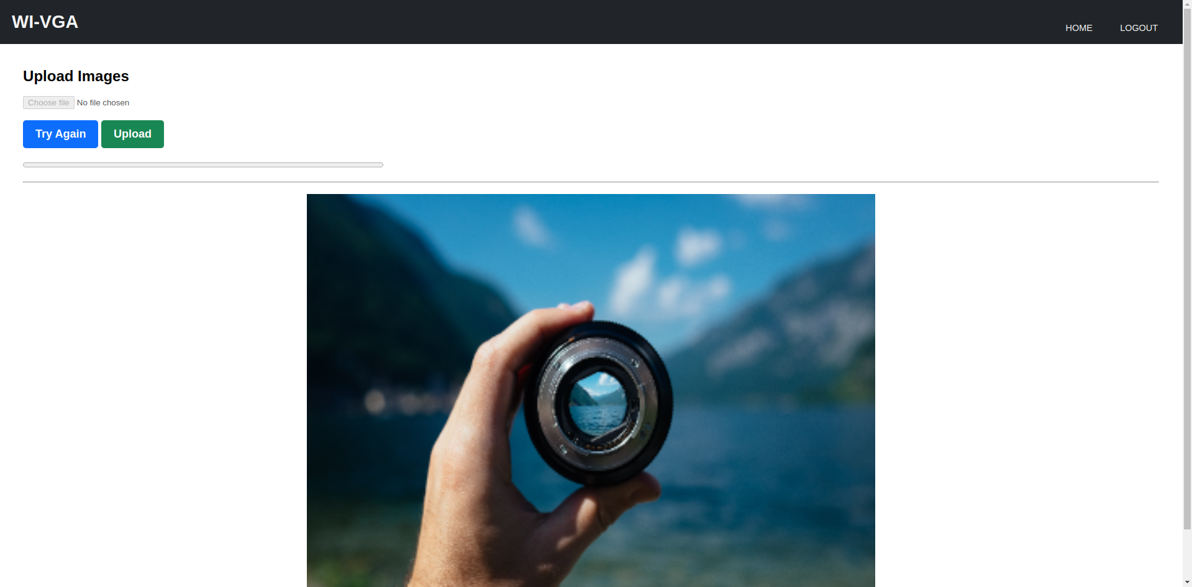
SCREENSHOT

Slide 36
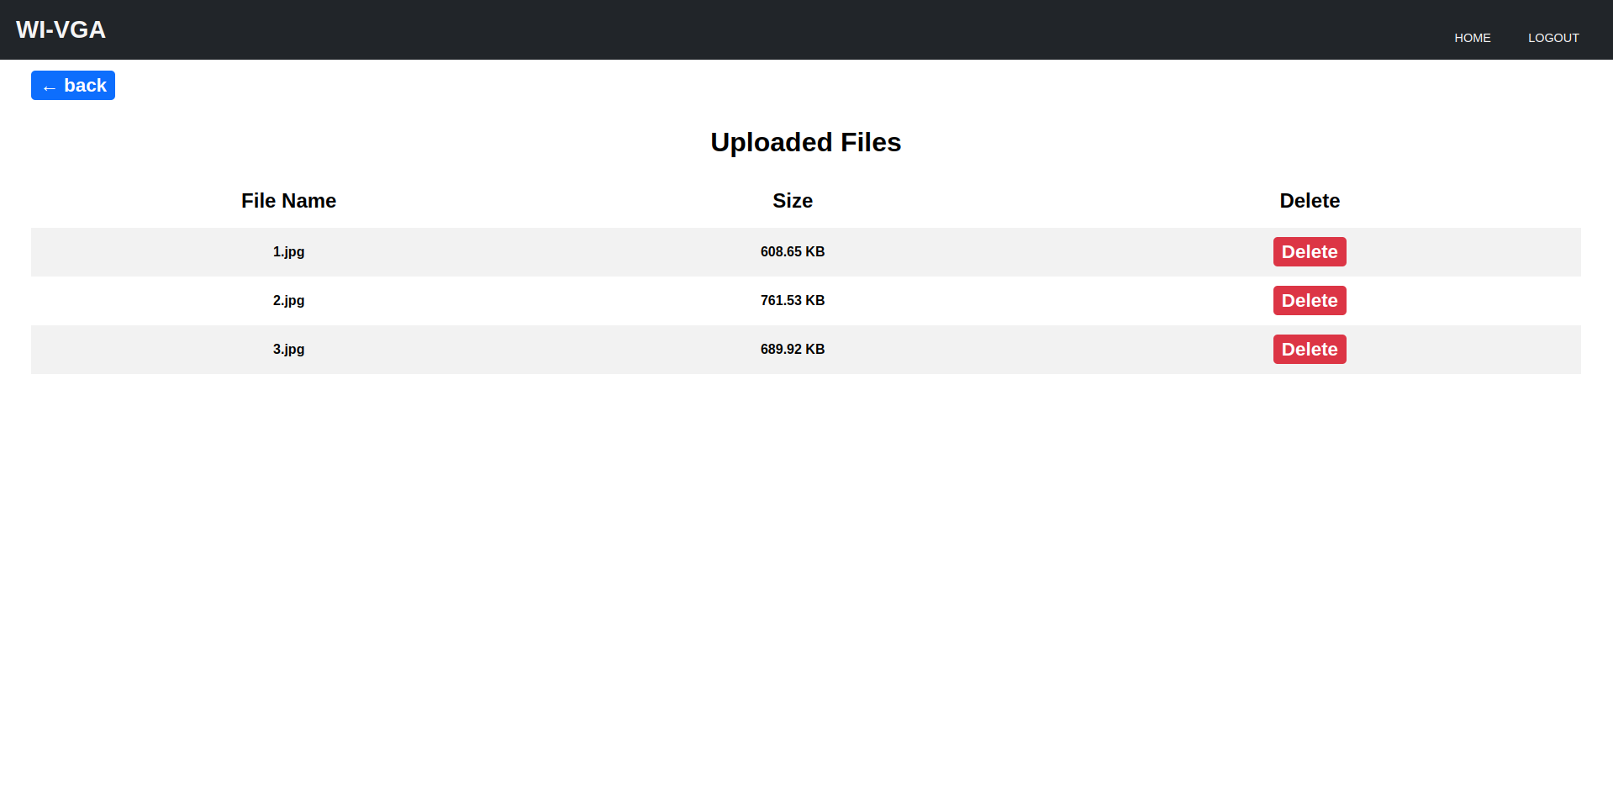

Slide 37
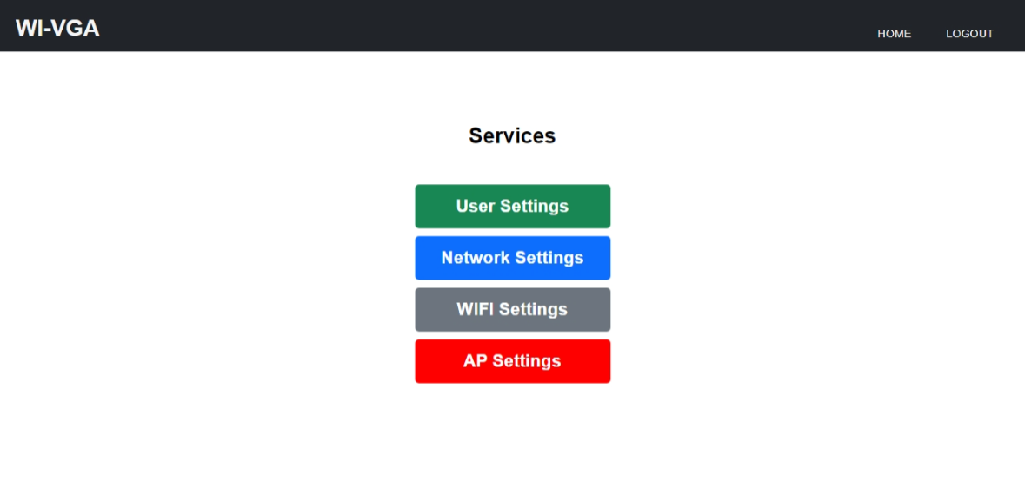

Slide 38
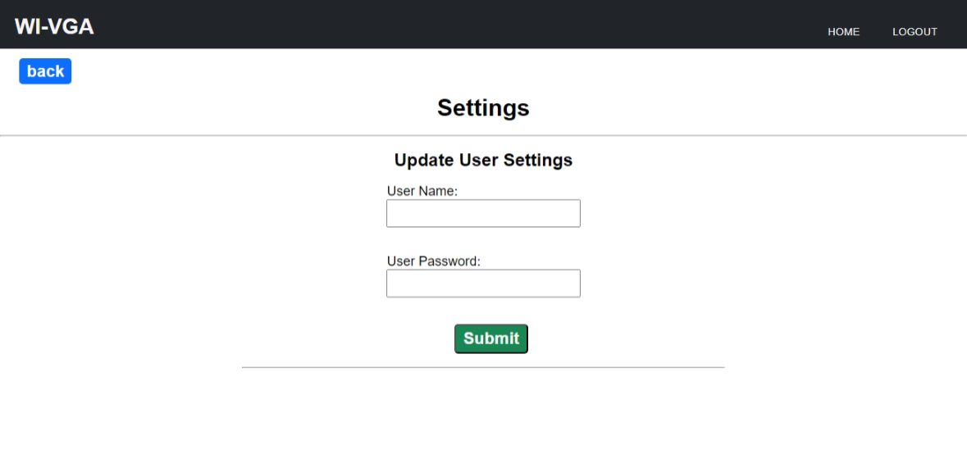
SCREEENSHOT

Slide 39
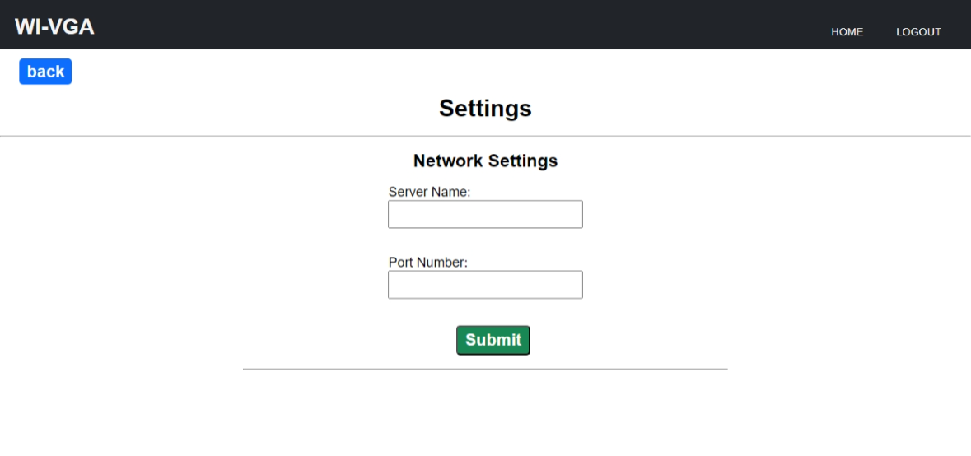

Slide 40
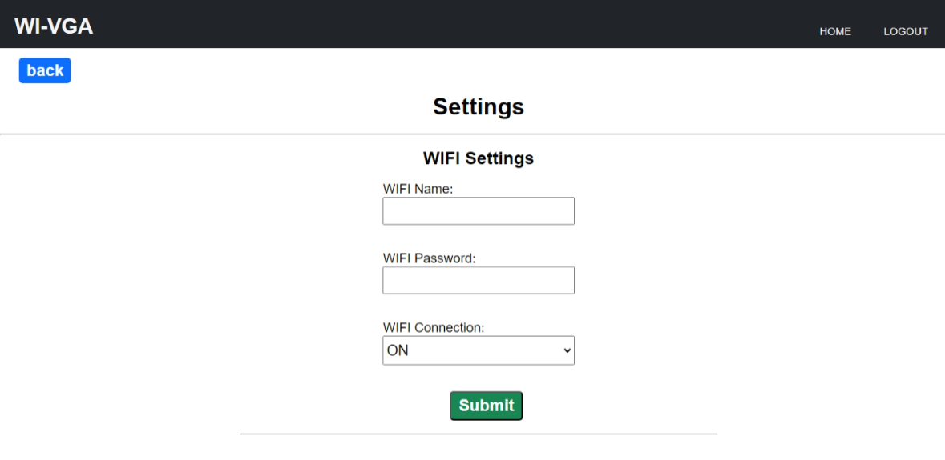

Slide 42
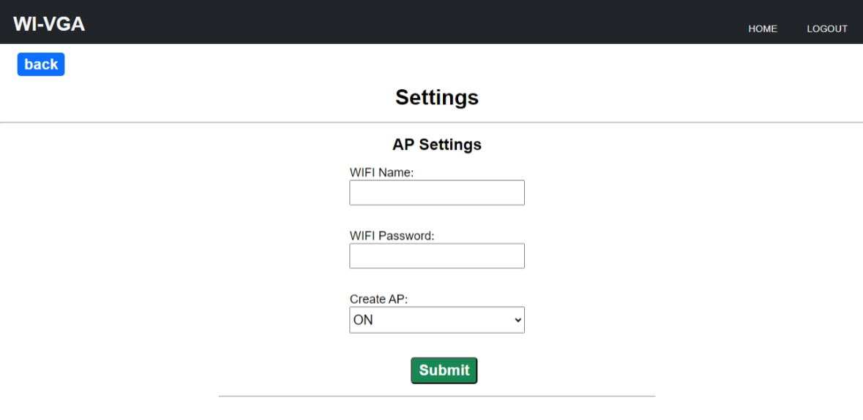

Slide 43
07
PWA

Slide 44
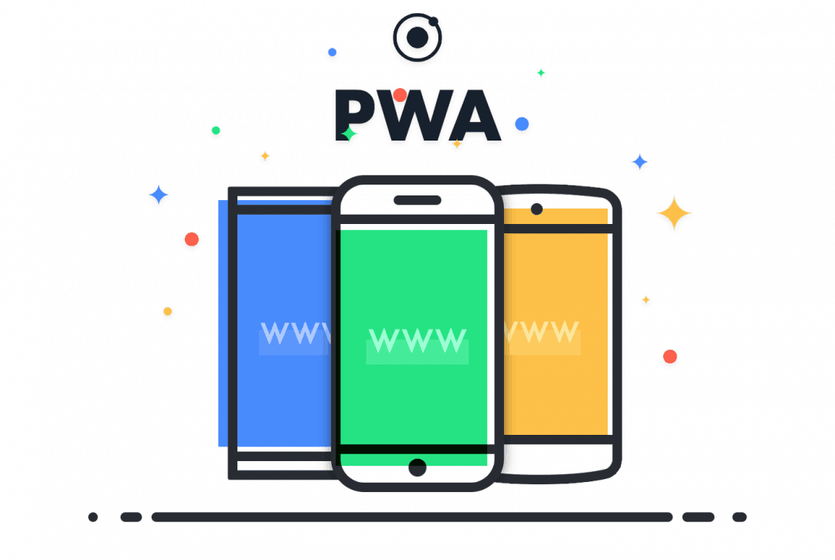

PWA VS FLUTTER
Platform Independence
Development Speed and Maintenance
User Experience
Notes:
Platform Independence:
PWA: Progressive Web Apps are web applications that can be accessed through a browser and are compatible with various platforms, including desktop and mobile.
Flutter: Flutter is a UI toolkit that allows you to build native-like applications for multiple platforms, including iOS, Android, web, and desktop. However, it requires you to write platform-specific code for each target platform.
User Experience:
PWA: PWAs can provide a good user experience, but they may not match the level of performance and smoothness offered by native applications. They rely on the capabilities of the user's web browser.
Flutter: Flutter provides a highly customizable and visually appealing user experience. It uses its own rendering engine, allowing for smooth animations and fast performance, resulting in a native-like feel across platforms.
Table-based Layout:
PWA: With PWA, you can create table-based layouts using HTML and CSS. You have a wide range of options for customizing the table design and functionality.
Flutter: Flutter provides a widget called "DataTable" that allows you to create table-based layouts easily. It offers extensive customization options for styling, sorting, and handling interactions with the table.
Offline Support:
PWA: Progressive Web Apps can work offline and cache data, allowing users to access and use the application even without an internet connection.
Flutter: Flutter applications can also offer offline support by caching data or using local storage mechanisms. However, it requires explicit implementation based on the specific requirements of the application.
Development Speed and Maintenance:
PWA: Building PWAs typically requires knowledge of web technologies such as HTML, CSS, and JavaScript. They can be developed faster and require less effort to maintain, especially if you already have a web development background.
Flutter: Flutter applications require learning Dart programming language and the Flutter framework. The development speed can be comparable to PWAs once you become familiar with the framework. However, maintenance might require platform-specific updates and bug fixes for different targets.

Slide 45
08
CONCLUSION

Slide 46
CONCLUSION
Objective: Convert an outdated VGA monitor into a functional billboard
Cost-effectiveness
Leveraging Modern Technology
Possibilities are endless with ESP32, Bitluni's libraries, and asynchronous web programming
Notes:
Cost-effectiveness:
Digital billboards are expensive
This project offers an affordable alternative
Repurposing old VGA monitors saves money
Leveraging Modern Technology:
ESP32 microcontroller's capabilities enable VGA output
Bitluni's libraries simplify programming
Access to powerful functionality with minimal effort

Slide 47
Demo

Slide 48
video
Notes:
Cost-effectiveness:
Digital billboards are expensive
This project offers an affordable alternative
Repurposing old VGA monitors saves money
Leveraging Modern Technology:
ESP32 microcontroller's capabilities enable VGA output
Bitluni's libraries simplify programming
Access to powerful functionality with minimal effort

Slide 49
09
FUTURE WORK

Slide 50
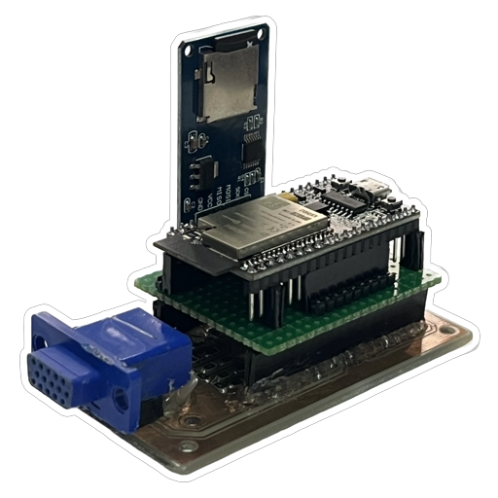
FUTURE WORK
Enhance system performance and meet growing client demands.
Facilitate seamless PDF file uploading and presentation
Notes:
Objective: Enhance system performance and meet growing client demands.
Acquiring a more powerful variant: ESP32S3 microcontroller.
Key features:
Higher resolution image handling capability.
Support for a larger number of web users.
Goal: Facilitate seamless PDF file uploading and presentation.
User-focused design for enhanced convenience and efficiency.
Benefits:
Effortless showcasing of PDFs directly from mobile devices.
Streamlined process for clients.
Improved user experience.

Slide 51
THANKS!

